Slide 1
Lead Scoring Case Study
Shubhabrata paul Choudhury

Slide 2
Introduction & Problem Statement
X Education, an online course provider, faces challenges with its low lead conversion rate (approximately 30%). Although the company acquires leads from multiple sources, including website visits, search engine marketing, and referrals, only a small percentage of these leads convert into paying customers. This inefficiency results in wasted efforts by the sales team, as they spend time communicating with all leads instead of focusing on the most promising ones.
To address this, the company aims to build a predictive model that assigns a lead score to each lead. Leads with higher scores should indicate a higher likelihood of conversion. By identifying these "Hot Leads", X Education hopes to optimize its sales process and achieve a target lead conversion rate of 80%.
The provided dataset contains ~9,000 leads with attributes like Lead Source, Total Time Spent on Website, and Last Activity. The target variable, Converted (1 for converted, 0 for not converted), will help build the model. Additionally, data preprocessing challenges, such as handling null values and irrelevant levels like "Select" in categorical variables, need to be addressed.

Slide 3

Goal of the Analysis

Slide 4

Data Exploration & Pre-processing
Among the provided dataset:
1. d skewness.
a. If the numerical column is almost symmetrical (normal distribution), replace the missing values with mean
b. If the numerical column is highly skewed (positive/negative), replace the missing values with median
c. For categorical column, replace the missing values based on domain knowledge and to the mode value.
3. Convert the continuous numerical value column to discrete categorical values by using some logic in custom function and introducing new columns using Feature Engineering.

Slide 5
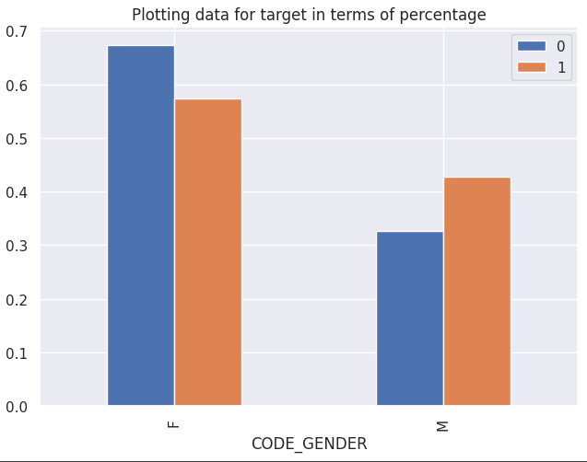
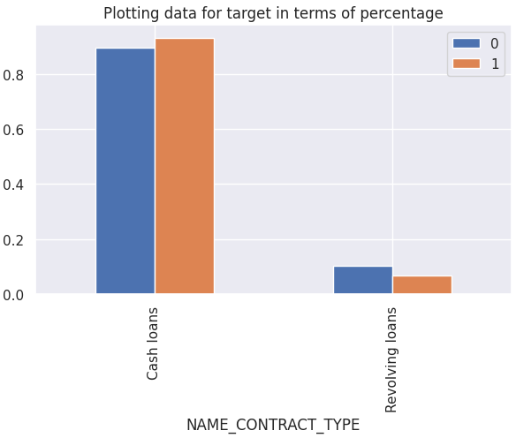
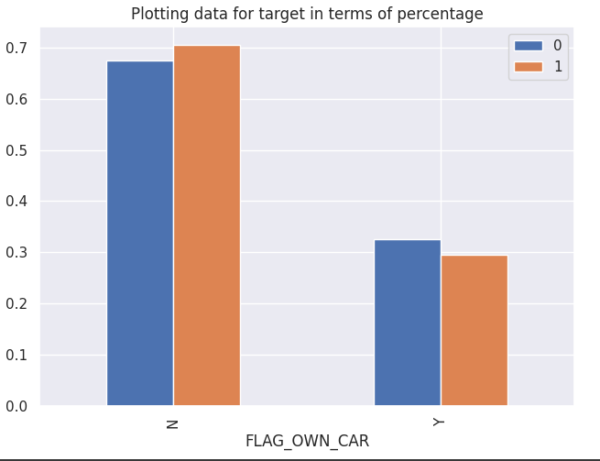
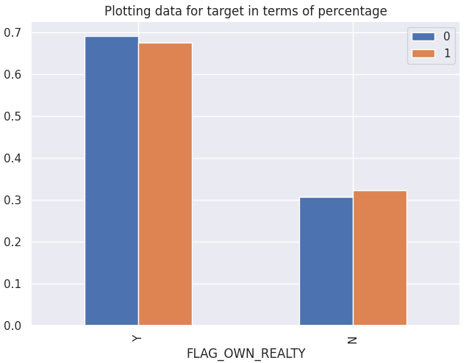
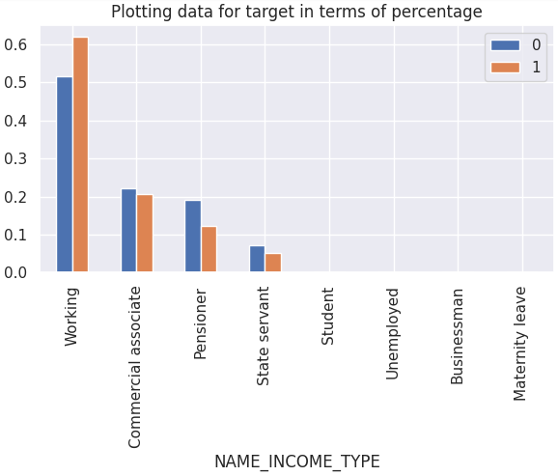
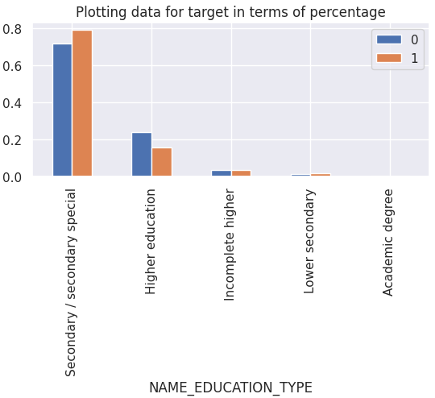

Key Insights from EDA
More Defaulters in Cash loans than in Revolving Loan
Female applicants default more than male
Applicants having own car are less prone to be defaulter
Applicants having own house/flat are having more difficulties in paying back
Working professionals are having more difficulties in paying back for their loan than Pensioners
Applicants with Secondary / Secondary special educations are having more difficulties in paying back

Slide 6
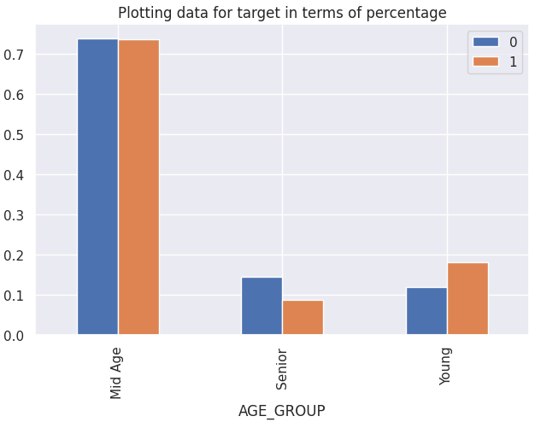
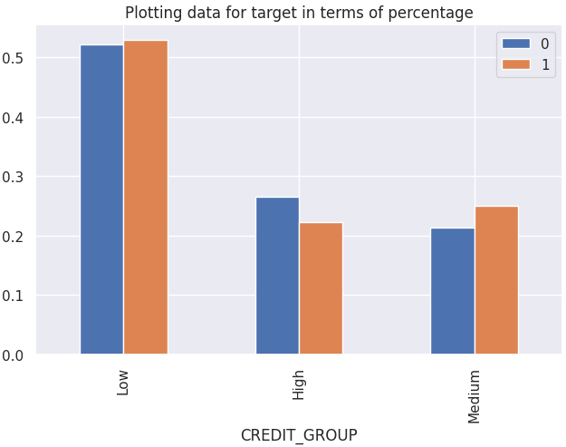
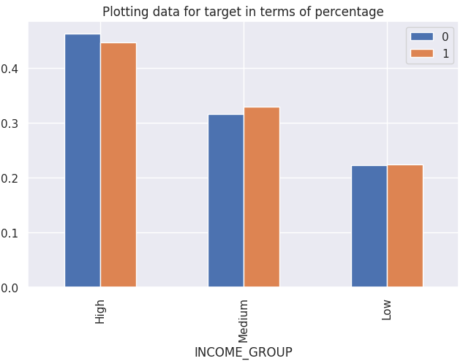
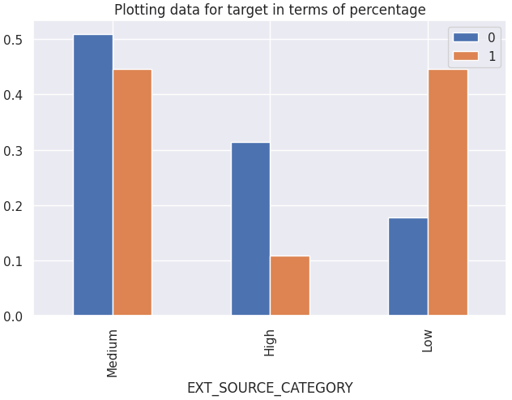
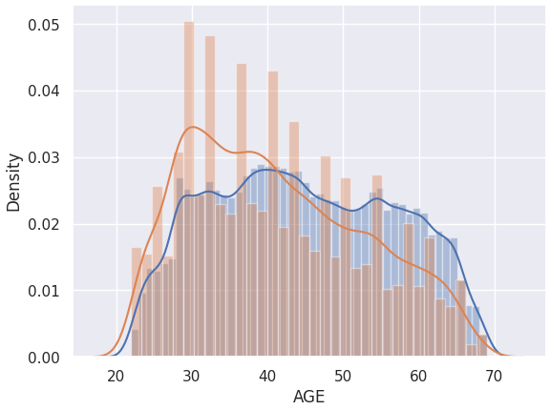
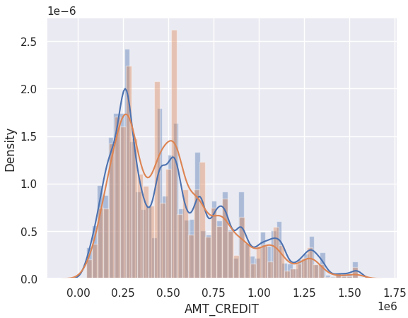
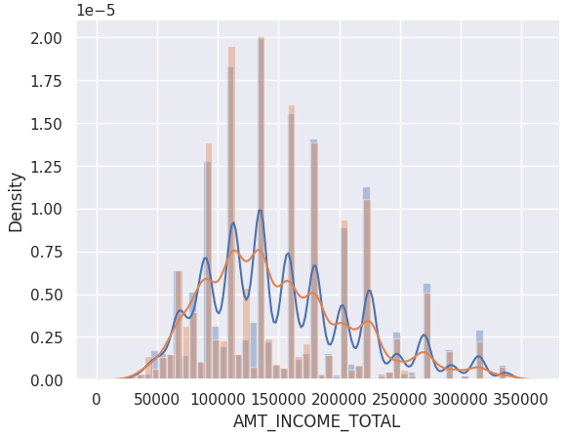
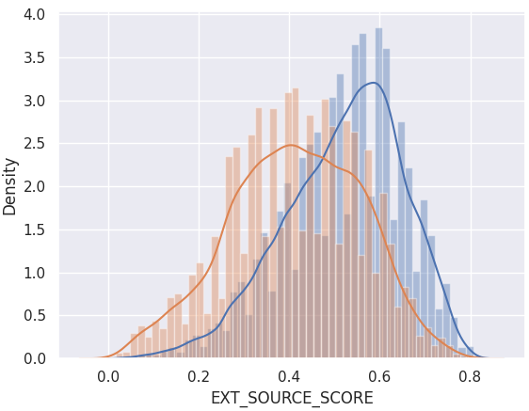
EDA Insights – Feature Engineering
4 Categorical columns have been created from the Numerical columns whose distribution is shown below.
Mid age group applicants are the highest defaulters. Interesting to see, Young age group find more difficulties in paying back than other cases.
Low and Medium Credit groups are top 2 defaulters and a risky segment whereas High Credit Group are the lowest defaulter.
Surprisingly, High income group has the highest defaulter, followed by Medium and Low income groups.
Low and Medium External source rating have the highest defaulters.

Slide 7
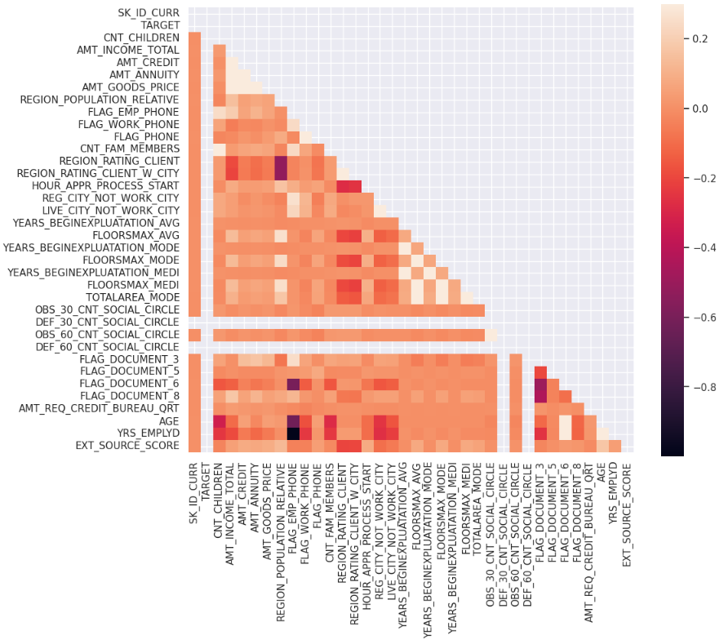
Model Development
Numerical field correlations are shown in the heatmap
Top 10 correlation of the numerical columns are as described in the table
Column 1 | Column 2 | Corr value
YRS_EMPLYD | FLAG_EMP_PHONE | 0.999622
AMT_GOODS_PRICE | AMT_CREDIT | 0.979252
CNT_FAM_MEMBERS | CNT_CHILDREN | 0.881405
LIVE_CITY_NOT_WORK_CITY | REG_CITY_NOT_WORK_CITY | 0.775526
AMT_ANNUITY | AMT_CREDIT | 0.743627
AMT_ANNUITY | AMT_GOODS_PRICE | 0.742843
YRS_EMPLYD | FLAG_DOCUMENT_6 | 0.618128
FLAG_DOCUMENT_6 | FLAG_EMP_PHONE | 0.617847
AGE | YRS_EMPLYD | 0.588006
FLAG_EMP_PHONE | AGE | 0.584457

Slide 8
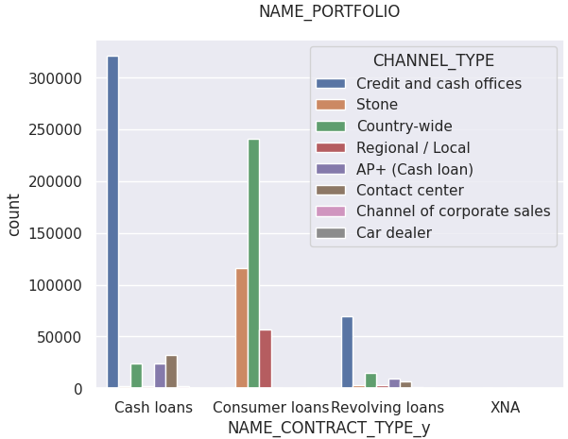
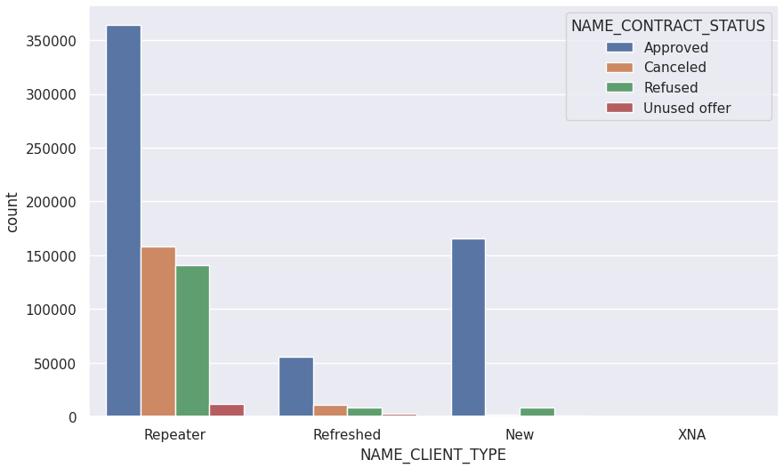
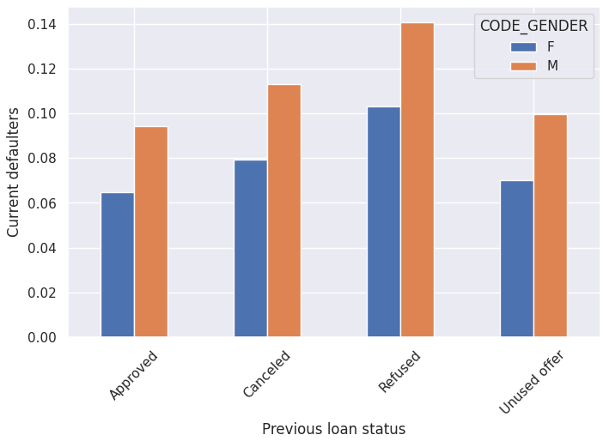
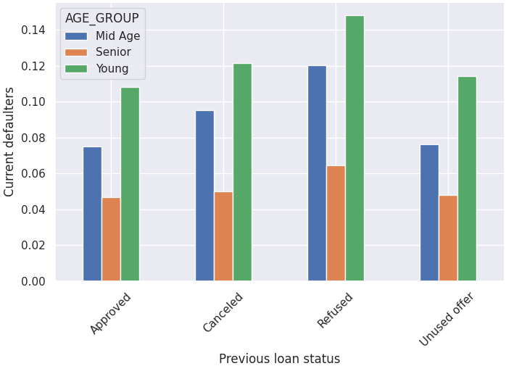
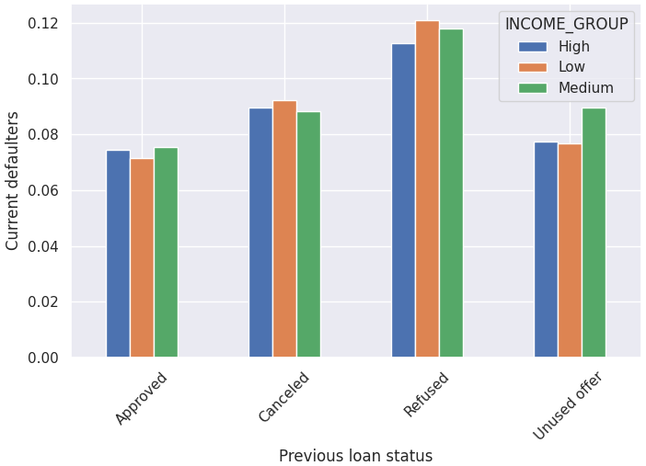
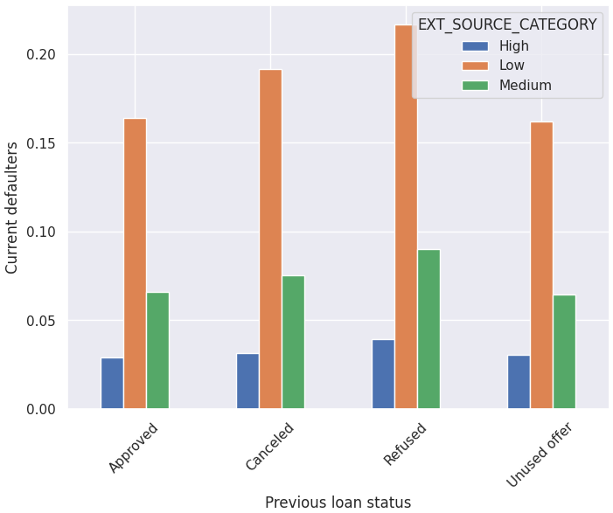
Model Performance
Loan Application and Approval
Repeater and new loan applicants are more likely to get loan approval compared to refreshed clients.
Cash and revolving loans are primarily processed via credit and cash offices, while consumer loans have country wide spread.
POS loans perform better through nationwide channels, whereas cash loans excel through credit and cash offices.
Customer Profile and Default Risk
Previously refused clients have higher default rates than previously approved. Males tend to default more than females.
Younger applicants have higher default rates across all previous application statuses, while senior applicants have lower default rates.
Customers with medium income levels have higher default rates for previously unused offers. Other income groups show similar default rates across different application statuses.
Applicants with low external source scores are at a higher risk of default, while those with high scores are less likely to default regardless of their loan history.

Slide 9
Driver for Lead Conversion
Loan Application and Approval
Repeater and new loan applicants are more likely to get loan approval compared to refreshed clients.
Cash and revolving loans are primarily processed via credit and cash offices, while consumer loans have country wide spread.
POS loans perform better through nationwide channels, whereas cash loans excel through credit and cash offices.
Customer Profile and Default Risk
Previously refused clients have higher default rates than previously approved. Males tend to default more than females.
Younger applicants have higher default rates across all previous application statuses, while senior applicants have lower default rates.
Customers with medium income levels have higher default rates for previously unused offers. Other income groups show similar default rates across different application statuses.
Applicants with low external source scores are at a higher risk of default, while those with high scores are less likely to default regardless of their loan history.

Slide 10

Strategy for Aggressive & Low Priority Lead
1. Predictive Modeling and Risk Management
Develop predictive models to forecast loan defaults based on EDA insights.
Fine-tune models to optimize loan approval and identify high-risk applicants.
Segment customers based on risk profiles for tailored loan offerings.
Enhance credit scoring systems using identified risk factors.
2. Business Optimization and Customer Focus
Implement targeted marketing and retention strategies based on EDA findings.
Optimize loan portfolio by focusing on profitable and low-risk segments.
Refine loan approval policies based on risk factors and broader strategic goals.
Establish ongoing monitoring and reporting of loan performance and default rates.
3. Data-Driven Decision Making and Compliance
Expand EDA scope with additional variables and external data sources.
Ensure compliance with regulatory requirements through EDA insights.
Implement customer education and support programs to improve creditworthiness.
Develop transparent reporting on responsible lending practices.

Slide 11

Recommendation & Action Plan
To optimize portfolio performance and minimize risk, the Customer Finance company should focus on acquiring and retaining the following customer segments:
Prime Customers:
Individuals with a proven track record of timely loan repayments
High-income earners with advanced education
Customers with strong credit profiles as evidenced by high external source scores
Senior Citizen with a stable financial history
Married couples with joint income
Female borrowers
Subprime Customer Segments Requiring Careful Assessment
While these segments present higher risk, there might be opportunities for tailored products and services:
Higher Risk Segments:
Customers with a history of loan defaults or payment irregularities
Low-income borrowers with previous loan rejections
Unemployed applicants
Customers with weak creditworthiness as indicated by low external source scores
Younger borrowers with limited credit history
Individuals with lower educational qualifications

Slide 12
Conclusion & Learning

Slide 13
Thank You !

